Slide 1


Structure of biological neurons relevant to ANNs
=============================================================================
WWW.THEMLLABS.COM || contact@themllabs.com || Phone : 91-7338339898, 91-6362546088

Slide 2
Agenda
Introduction to Artificial neural network(ANN)
What is Biological Neuron
Comparing ANN & BNN
Analogy of ANN with BNN
Model of Artificial Neural Network
Architecture
=============================================================================
WWW.THEMLLABS.COM || contact@themllabs.com || Phone : 91-7338339898, 91-6362546088

Slide 3
Introduction to Artificial neural network(ANN)
Artificial Neural Network (ANN) is an efficient computing system whose central theme is borrowed from the analogy of biological neural networks.
ANNs are also named as “artificial neural systems,” or “parallel distributed processing systems,” or “connectionist systems.”
ANN acquires a large collection of units that are interconnected in some pattern to allow communication between the units
=============================================================================
WWW.THEMLLABS.COM || contact@themllabs.com || Phone : 91-7338339898, 91-6362546088

Slide 4
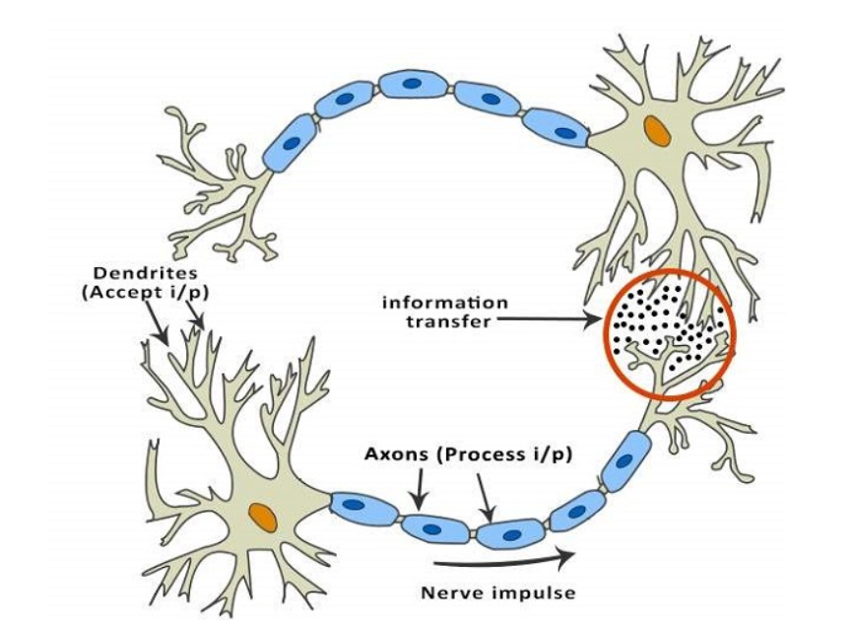
ANN
=============================================================================
WWW.THEMLLABS.COM || contact@themllabs.com || Phone : 91-7338339898, 91-6362546088

Slide 5
• Every neuron is connected with other neuron through a connection link.
Each connection link is associated with a weight that has information about the input signal.
• Each neuron has an internal state, which is called an activation signal.
Output signals, which are produced after combining the input signals and activation rule, may be sent to other units.
=============================================================================
WWW.THEMLLABS.COM || contact@themllabs.com || Phone : 91-7338339898, 91-6362546088

Slide 6
What is Biological Neuron
A neuron (also known as a neuron or nerve cell) is a cell that carries electrical impulses. Neurons are the basic units of the nervous system and its most important part is the brain.
Every neuron is made of a cell body (also called a soma), dendrites and an axon.
Dendrites and axons are nerve fibers. There are about 86 billion neurons in the human brain, which comprises roughly 10% of all brain cells. The neurons are supported by glial cells and astrocytes.
=============================================================================
WWW.THEMLLABS.COM || contact@themllabs.com || Phone : 91-7338339898, 91-6362546088

Slide 7
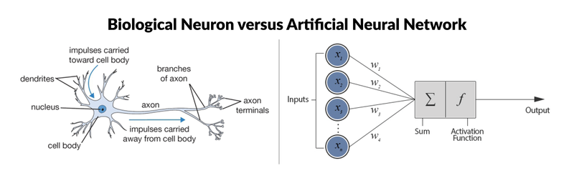
=============================================================================
WWW.THEMLLABS.COM || contact@themllabs.com || Phone : 91-7338339898, 91-6362546088

Slide 8
Dendrite — It receives signals from other neurons.
Soma (cell body) — It sums all the incoming signals to generate input.
Axon — When the sum reaches a threshold value, neuron fires and the signal travels down the axon to the other neurons.
Synapses — The point of interconnection of one neuron with other neurons.
The amount of signal transmitted depend upon the strength (synaptic weights) of the connections.
The connections can be inhibitory (decreasing strength) or excitatory (increasing strength) in nature.
Neural network, in general, is a highly interconnected network of billions of neuron with trillion of interconnections between them.
=============================================================================
WWW.THEMLLABS.COM || contact@themllabs.com || Phone : 91-7338339898, 91-6362546088

Slide 9
BRAIN
Biological Neurons or Nerve Cells.
200 Billion Neurons, 32 trillion interconnections.
Neuron Size: 10-6m.
Energy Consumption: 6-10 Joules operation / sec
Learning Capability
COMPUTERS
Single Transistor
1 Billion bytes RAM, trillion of bytes on disk.
Single Transistor Size: 10-9m..
Energy Consumption: 10-16 Joules Operation / sec
Programming capability
=============================================================================
WWW.THEMLLABS.COM || contact@themllabs.com || Phone : 91-7338339898, 91-6362546088

Slide 10
Comparing ANN & BNN
As this concept borrowed from ANN there are lot of similarities though there are differences too.
Biological Neural Network Soma
Dendrites
Synapse
Axon
Artificial Neural Network Node
Input
Weight or Interconnections
Output
=============================================================================
WWW.THEMLLABS.COM || contact@themllabs.com || Phone : 91-7338339898, 91-6362546088

Slide 11
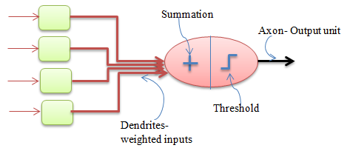
Analogy of ANN with BNN
=============================================================================
WWW.THEMLLABS.COM || contact@themllabs.com || Phone : 91-7338339898, 91-6362546088

Slide 12
The dendrites in biological neural network is analogous to the weighted inputs based on their synaptic interconnection in artificial neural network.
Cell body is analogous to the artificial neuron unit in artificial neural network which also comprises of summation and threshold unit.
Axon carry output that is analogous to the output unit in case of artificial neural network. So, ANN are modelled using the working of basic biological neurons.
=============================================================================
WWW.THEMLLABS.COM || contact@themllabs.com || Phone : 91-7338339898, 91-6362546088

Slide 13
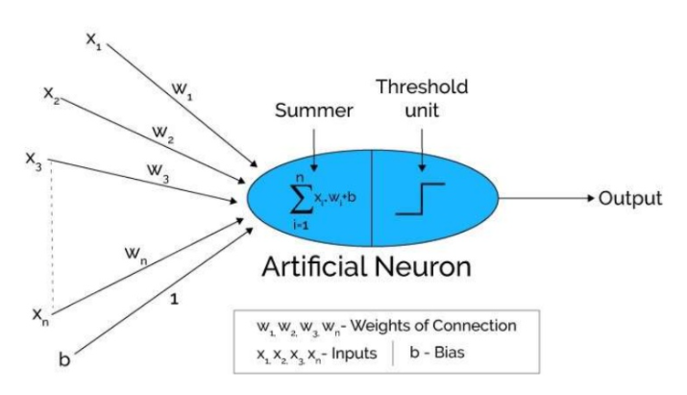
Model of Artificial Neural Network
=============================================================================
WWW.THEMLLABS.COM || contact@themllabs.com || Phone : 91-7338339898, 91-6362546088

Slide 14
Artificial neural networks can be viewed as weighted directed graphs in which artificial neurons are nodes and directed edges with weights are connections between neuron outputs and neuron inputs.
The Artificial Neural Network receives input from the external world in the form of pattern and image in vector form.
These inputs are mathematically designated by the notation x(n) for n number of inputs.
=============================================================================
WWW.THEMLLABS.COM || contact@themllabs.com || Phone : 91-7338339898, 91-6362546088

Slide 15
Each input is multiplied by its corresponding weights. Weights are the information used by the neural network to solve a problem.
For this, the sum is passed through activation function.
Typically weight represents the strength of the interconnection between neurons inside the neural network.
The weighted inputs are all summed up inside computing unit (artificial neuron).
=============================================================================
WWW.THEMLLABS.COM || contact@themllabs.com || Phone : 91-7338339898, 91-6362546088

Slide 16
In case the weighted sum is zero, bias is added to make the output not- zero or to scale up the system response. Bias has the weight and input always equal to ‘1’.
The sum corresponds to any numerical value ranging from 0 to infinity. In order to limit the response to arrive at desired value, the threshold value is set up. For this, the sum is passed through activation function.
The activation function is set of the transfer function used to get desired output. There are linear as well as the non-linear activation function.
=============================================================================
WWW.THEMLLABS.COM || contact@themllabs.com || Phone : 91-7338339898, 91-6362546088

Slide 17
Some of the commonly used activation function are: binary, sigmoidal (linear)and tan hyperbolic sigmoidal functions(nonlinear) Binary — The output has only two values either 0 and 1. If the net weighted input is greater than 1, an output is assumed 1 otherwise zero.
Sigmoidal Hyperbolic — This function has ‘S’ shaped curve. Here tan hyperbolic function is used to approximate output from net input. The function is defined as — f (x) = (1/1+ exp(-𝝈x)) where 𝝈— steepness parameter. Model of Artificial Neural Network
=============================================================================
WWW.THEMLLABS.COM || contact@themllabs.com || Phone : 91-7338339898, 91-6362546088

Slide 18
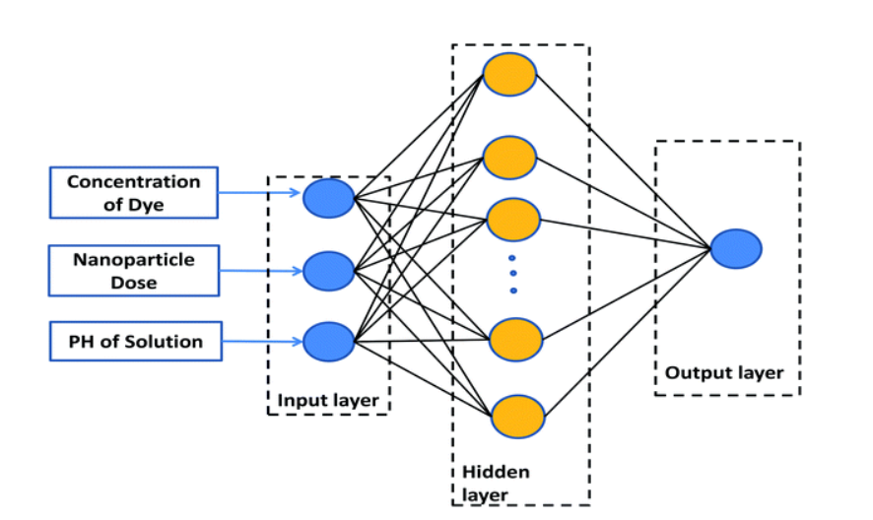
Architecture
=============================================================================
WWW.THEMLLABS.COM || contact@themllabs.com || Phone : 91-7338339898, 91-6362546088

Slide 19
Architecture A typical neural network contains a large number of artificial neurons called units arranged in a series of layers. In typical artificial neural network, comprises different layers -
Input layer — It contains those units (artificial neurons) which receive input from the outside world on which network will learn, recognize about or otherwise process.
Output layer — It contains units that respond to the information about how it’s learned any task.
Hidden layer — These units are in between input and output layers. The job of hidden layer is to transform the input into something that output unit can use in some way.
=============================================================================
WWW.THEMLLABS.COM || contact@themllabs.com || Phone : 91-7338339898, 91-6362546088

Slide 20
• Most neural networks are fully connected that means to say each hidden neuron is fully connected to the every neuron in its previous layer(input) and to the next layer (output) layer
• Most neural networks are fully connected that means to say each hidden neuron is fully connected to the every neuron in its previous layer(input) and to the next layer (output) layer
=============================================================================
WWW.THEMLLABS.COM || contact@themllabs.com || Phone : 91-7338339898, 91-6362546088

